Slide 1
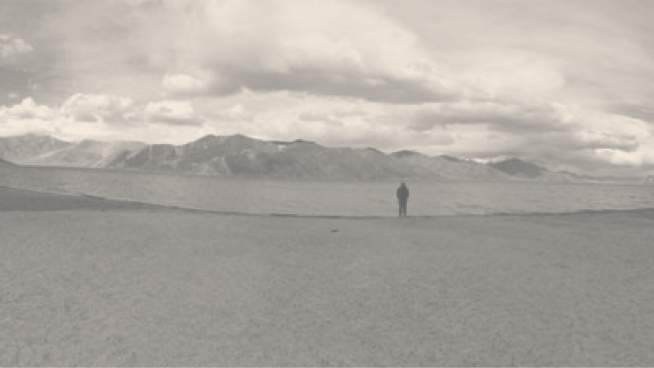

S A N C H A L I A G G A R W A L
DESIGN | BUSINESS | FASHION | WRITING | CONTACT
I make creative projects come to life. Then, I sell them.
Sanchali Aggarwal is a brand and product manager with a background in fashion, apparel, and lifestyle focusing on creative and revenue outcomes.
Let’s work together
Recent Work
< Previous
See All >
Pumped up kicks
Led and developed an in house pilot project to make the brand appealing for YUPPYs and HENRYs to move the iconic international brand’s Indian share in a saturated, competitive market
+ Increased Brand Visibility
+ Awarded Most Promising
+ Set Design Best Practices

